Slide 1




Slide 2

TEST TIME ON DATA INTERPRETATION-1
URL: https://forms.gle/K4Bn83ikppVWXBzM7
QR CODE:

Slide 3

DATA INTERPRETATION-2

Slide 4
DATA INTERPRETATION
Data Interpretation is one of the most interesting chapter as it deals with real world scenarios where analysis is based on consideration of the data given and analysis.
Questions from this chapter can be based on:
Bar Graph
Line Graph
Pie Chart
Data Table
Notes:
It tests your constraint programming skills

Slide 5
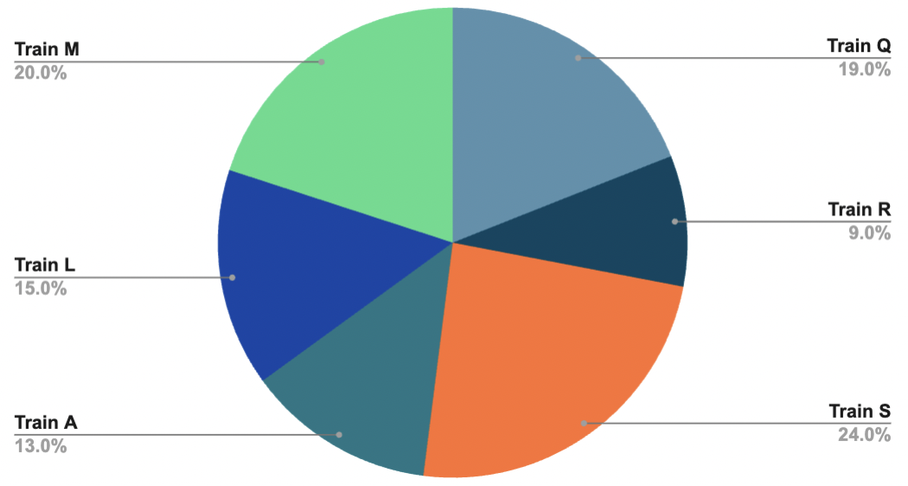
Question: 01
Study the following pie chart carefully to answer the questions.
Given in the following pie chart
Percentage of passengers and The total number of passengers = 8500.
What was the approximate average number of passengers in Train-S, Train-M and Train-L together?
1521
1641
1651
1671

Slide 6
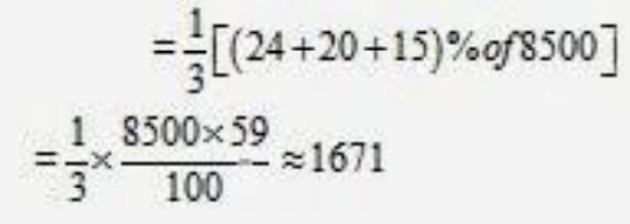
Explanation: 01
Required no. of passengers

Slide 7
Question: 02
If in Train-R 34% of the passengers are females and 26% are children, what is the number of males in that train?
306
316
308
318

Slide 8
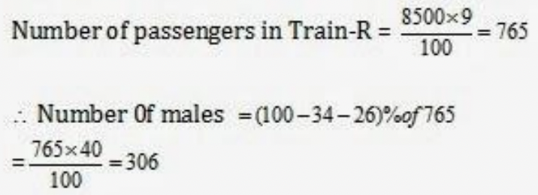
Explanation: 02

Slide 9
Question: 01
Question: 03
The number of passengers in Train-Q is approximately what percent of the total number of passengers in Train–A and Train-R?
90
70
75
86

Slide 10
Explanation:
Explanation: 03
Reqd% = (19) / ( 13 + 9 ) x 100 =86 ( approx)

Slide 11
Question: 04
Which train has highest number of passengers?
A
Q
S
M
L

Slide 12
Explanation: 04
It is clear from the pie chart S

Slide 13
Question: 05
How many more percent (approximately) number of passengers are there in Train-M as compared to the number of passengers in Train-L?
29
49
43
33

Slide 14
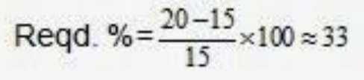
Explanation: 05

Slide 15
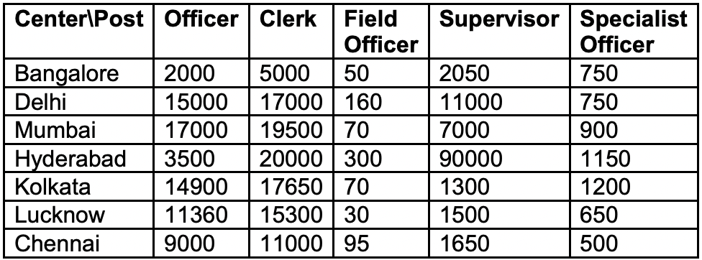
Question: 06
Study the following table to answer the given questions.
Number of Specialist officer in Kolkata is approximately what percent of that officer?
8.7
8
6.5
9

Slide 16
Explanation: 06
In Kolkata No. of officers =14900 No. of Specialist officer = 1200 Req. aaprox. Percentage: = 1200x100/15000 = 8 (approx)

Slide 17
Question: 07
Study the following table to answer the given questions.
What is the difference between total number for officers and Clerks?
29,680
34,180
32,690
28,680

Slide 18
Explanation: 07
Total No. of officers = 72,760
Total No. of Clerks = 105,450 Req.
difference = 32,690

Slide 19
Question: 08
Study the following table to answer the given questions.
In Chennai number of clerks is approximately how much percent more than that of officers?
18
22
20
2

Slide 20
Explanation: 08
In Chennai No. of Clerks = 11000
No. of officers = 9000
Req Percentage = 11000 – 9000/9000 x 100 = 22.2 = 22

Slide 21
Question: 02
Question: 09
Which center has 300% more number of clerks as compared to Bangalore?
Lucknow
Mumbai
Hyderabad
Chennai
None

Slide 22
Explanation:
Explanation: 09
5000 + 300% of 5000 = 20,000
Hyderabad is req. answer.

Slide 23
Question: 10
Which center has the highest number of candidates?
Delhi
Kolkata
Hyderabad
Mumbai
None

Slide 24
Explanation:
Explanation: 10
Hyderabad

Slide 25
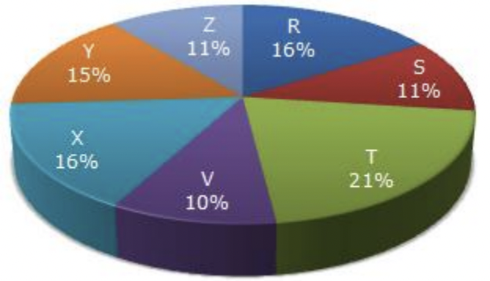
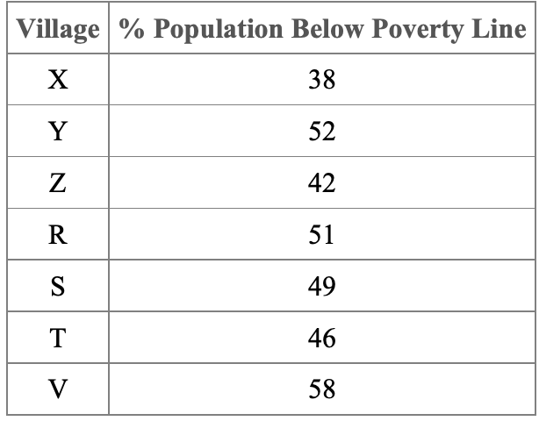
Question: 11
Study the following pie-chart and the table and answer the questions based on them. Proportion of Population of Seven Villages in 1997
If the population of village R in 1997 is 32000, then what will be the population of village Y below poverty line in that year?
14100
15600
16500
17000

Slide 26
Explanation:
Explanation: 11
B

Slide 27
Question: 12
Study the following pie-chart and the table and answer the questions based on them. Proportion of Population of Seven Villages in 1997
The ratio of population of village T below poverty line to that of village Z below poverty line in 1997 is:
A. 11 : 23
B. 13 : 11
C. 23 : 11
D. 11 : 13

Slide 28
Explanation:
Explanation: 12
Let X be the total population of all the 7 villages.
Then, population of village T below poverty line = 46% of (21% of X)
population of village Z below poverty line = 42% of (11% of X)
required ration = 46%of (21% of X)/42% of (11%of x) =23/11

Slide 29
Question: 13
Study the following pie-chart and the table and answer the questions based on them. Proportion of Population of Seven Villages in 1997
Find the population of village S if the population of village X below poverty line in 1997 is 12160.
A. 18500
B. 20500
C. 22000
D. 26000

Slide 30
Explanation:
Explanation: 13
C

Slide 31
Question: 14
Study the following pie-chart and the table and answer the questions based on them. Proportion of Population of Seven Villages in 1997
If in 1998, the population of villages Y and V increase by 10% each and the percentage of population below poverty line remains unchanged for all the villages, then find the population of village V below poverty line in 1998, given that the population of village Y in 1997 was 30000.
A. 11250
B. 12760
C. 13140
D. 13780

Slide 32
Explanation:
Explanation: 14
B

Slide 33
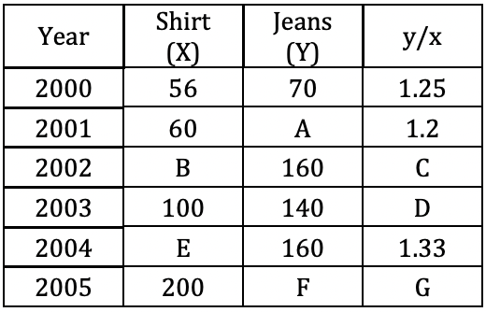
Question: 15
Study the following table carefully and answer the questions that follow. A few data are assigned alphabetically: (Sales of shirts and jeans sold by Co. X in various years, Rs. Crores)
The percent increase in the shirts’ sale between years 2002 and 2004 is:
40%
50%
45%
60%
can’t say

Slide 34
Explanation:
Explanation: 15
E
Since B cannot be found from given data.

Slide 35
Question: 16
Study the following table carefully and answer the questions that follow. A few data are assigned alphabetically: (Sales of shirts and jeans sold by Co. X in various years, Rs. Crores)
The percent increase in the jeans’ sale between 2001 and 2005 is:
75%
37.5%
375%
750%
Can’t be determined

Slide 36
Explanation:
Explanation: 16
E
Since F cannot be found from given data.

Slide 37
Question: 17
Study the following table carefully and answer the questions that follow. A few data are assigned alphabetically: (Sales of shirts and jeans sold by Co. X in various years, Rs. Crores)
If G = 1.5, what percent is sales of jeans in 2005 of sales of jeans in 2002?
150
175
187.5
160
190.5

Slide 38
Explanation:
Explanation: 17
F/200 = 1.5
F = 300
Required percentage = = 187.5

Slide 39
Question: 18
Study the following table carefully and answer the questions that follow. A few data are assigned alphabetically: (Sales of shirts and jeans sold by Co. X in various years, Rs. Crores)
If C : D = 1 : 2 then 7B = ?
1500
1250
1600
1800
None
Notes:
D

Slide 40
Explanation:
Explanation: 18
C/D =1/2
C = 0.7
160/B = 0.7
B = 1600/7
7B = 1600

Slide 41
Question: 19
Study the following table carefully and answer the questions that follow. A few data are assigned alphabetically: (Sales of shirts and jeans sold by Co. X in various years, Rs. Crores)
The value of A : E is:
0.6
0.8
1.0
1.2
1.5

Slide 42
Explanation:
Explanation: 19
A/E = 72/120 = 0.6

Slide 43

https://learn.codemithra.com

Slide 44




THANK YOU
+91 78150 95095
codemithra@ethnus.com
www.codemithra.com

